Slide 1
Reception
for Parents

Slide 2
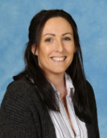
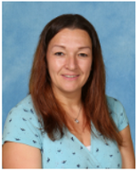
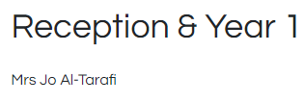
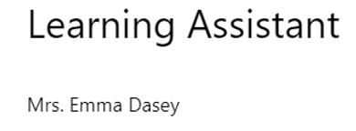
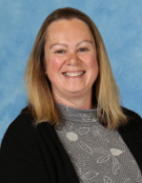
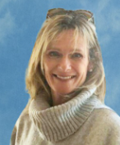
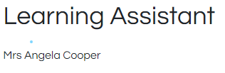
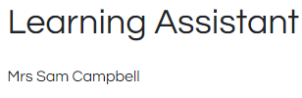

Key Staff and their training

Slide 3
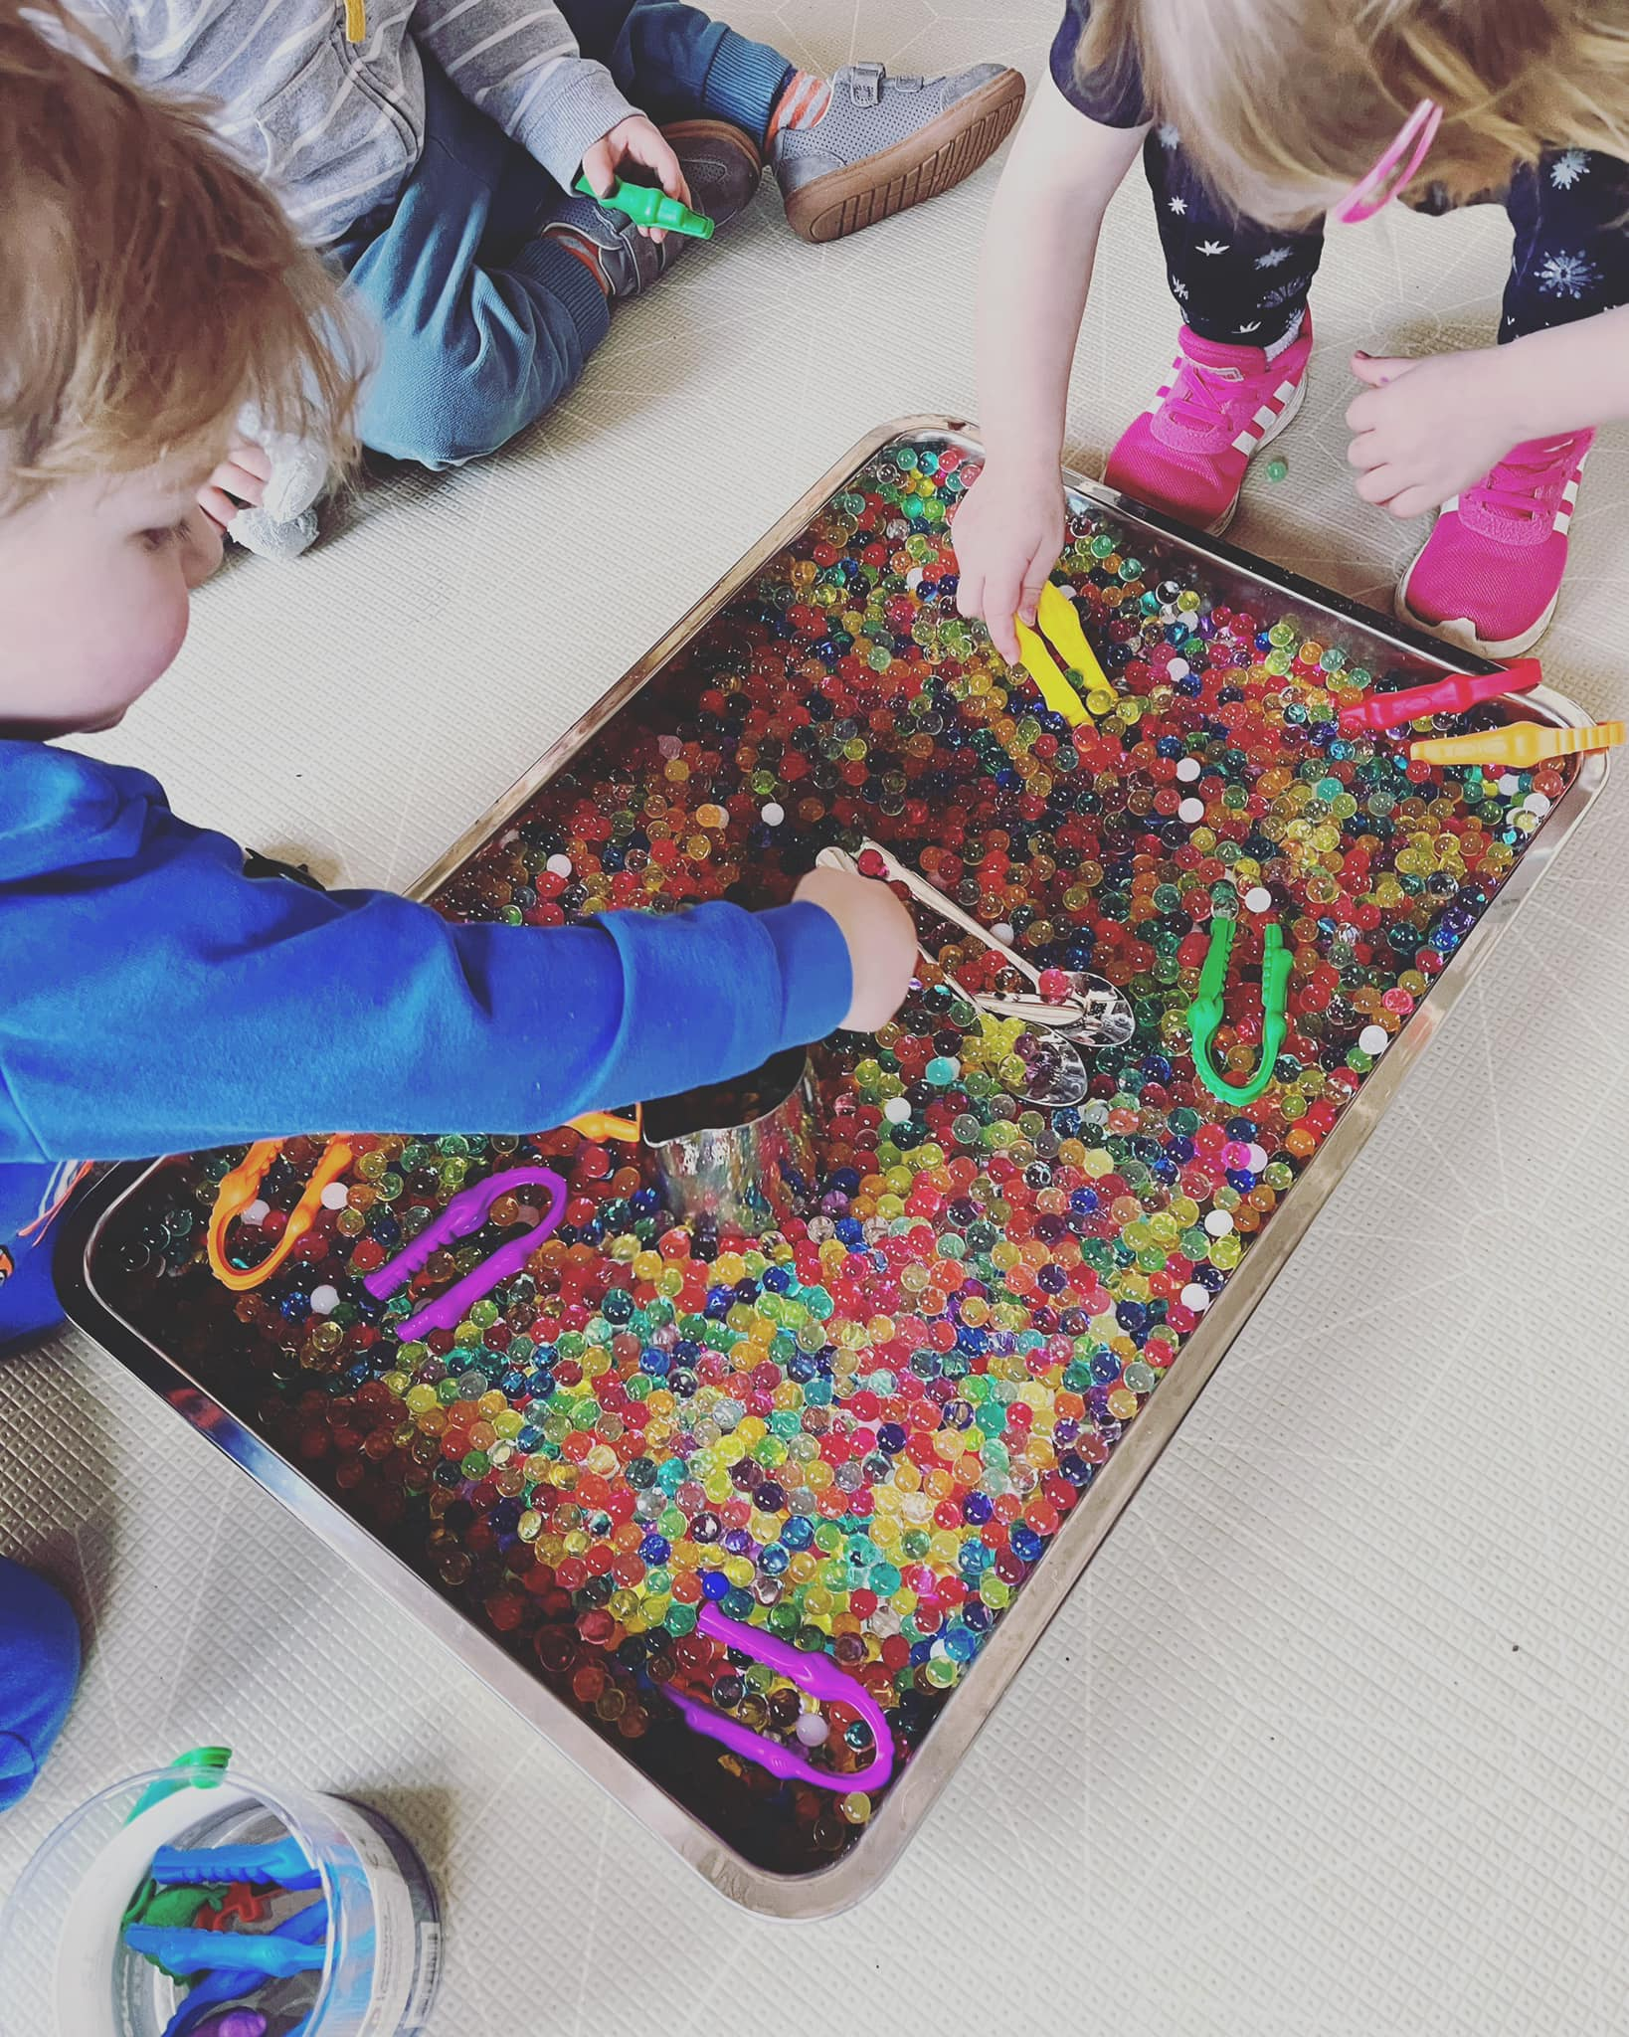
Learning in the Early Years
- Exciting environment
- Child initiated activities
- Adult interaction
- Observations
- Phonics
- Play

Slide 4
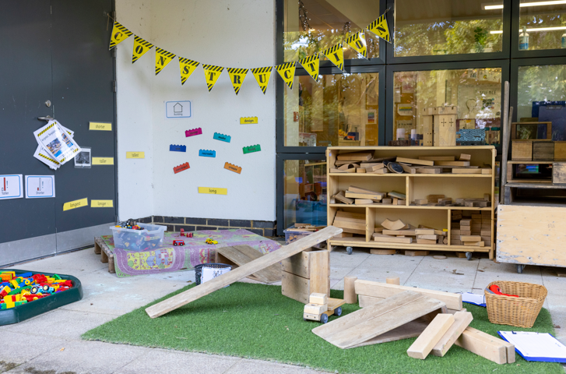
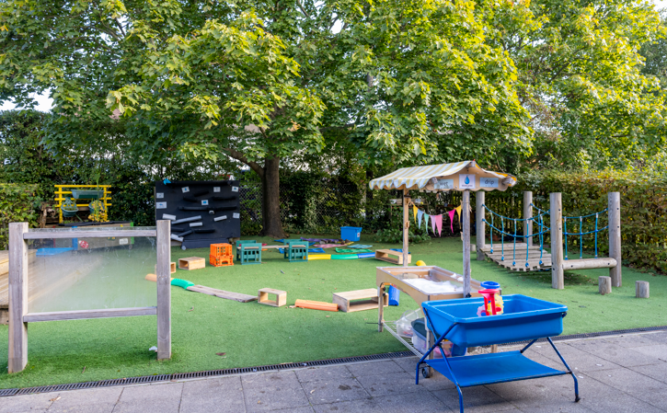
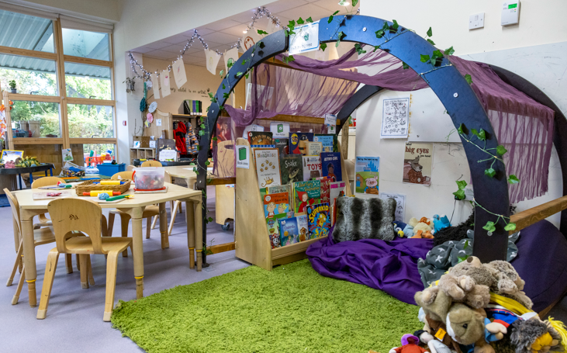
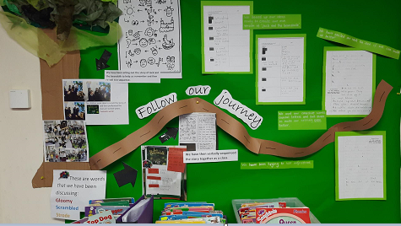
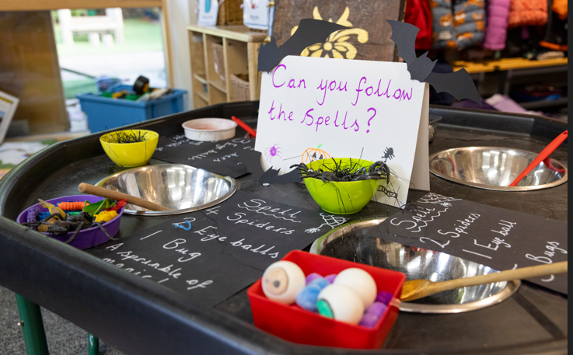
Our Learning Environment

Slide 5
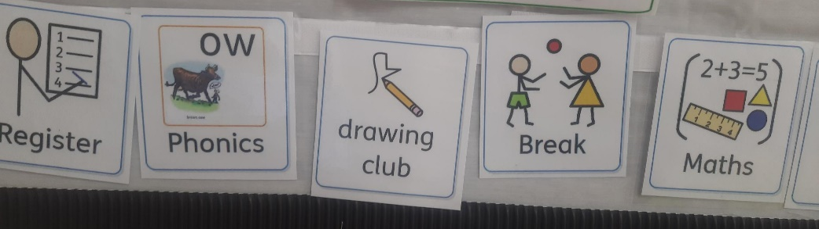
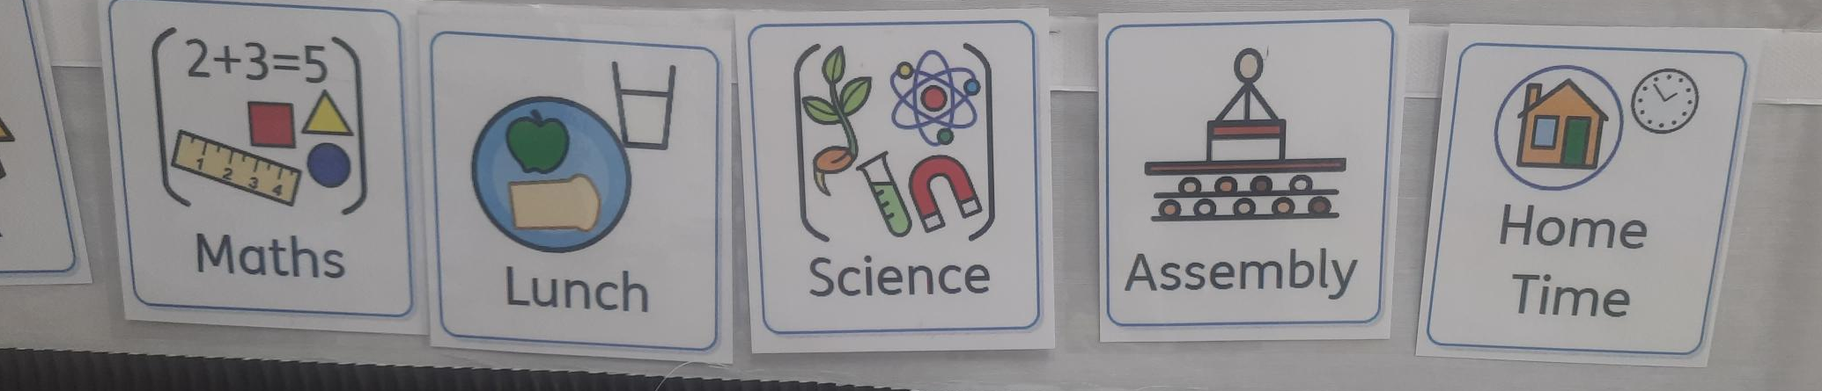
A day in the life of a Reception Child

Slide 6
Induction Plan
Home visits.
Talking to and visiting nursery/pre-school providers in order to gain an insight into your child.
Childs visit to school.
Staggered start in September.

Slide 7
Keeping you informed
Website, Facebook, Seesaw
Information evenings
Parent meetings
Learning Journeys
PTA pta@barnsgreen.org.uk
School newsletter

Slide 8
How you can help at home
Spend time together talking about school
Provide opportunities for chatting, playing and interacting together
Spend time together reading, telling stories and singing
Play games that involve turn taking
Encourage independence – getting dressed, putting on coat and shoes, washing/ drying hands and using the toilet

Slide 9
Thank you for attending
Do you have any questions?

